Slide 1















Encryption & Decryption Project
Presented to:
Md. Jahidul Alam
Lecturer
Dept. of CSE
Daffodil International University

Slide 2

Outline
Introduction
Objectives
Benefits of the Project
User Interface
Hardware Specifications
Project Demo
Conclusion

Slide 3
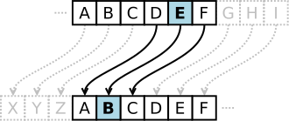
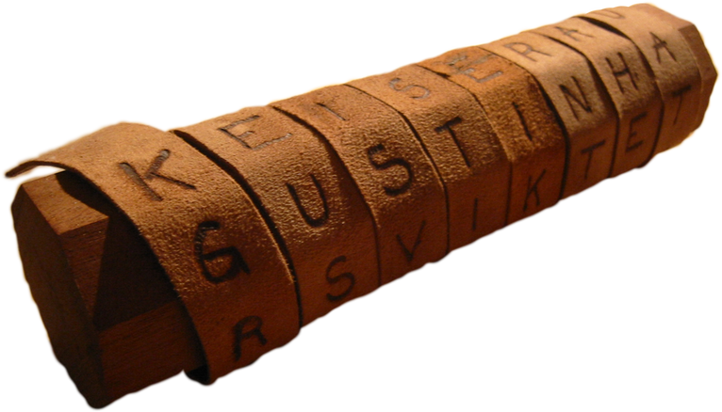
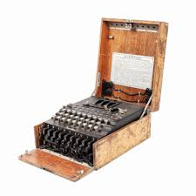
Introduction
Encryption transforms readable data (plaintext) into an unreadable format (ciphertext) using algorithms and keys. Decryption reverses this process, converting ciphertext back into plaintext using a decryption key.
Historical Background
Ancient Techniques:
Caesar Cipher (50 BCE): Shifted letters in the alphabet, used by Julius Caesar for secure communication.
Scytale (5th Century BCE): A Spartan tool encrypting messages on parchment wrapped around a rod.
Modern Evolution:
The Enigma Machine in WWII revolutionized encryption for military use.
The 1970s introduced RSA, pioneering asymmetric encryption in cybersecurity.

Slide 4
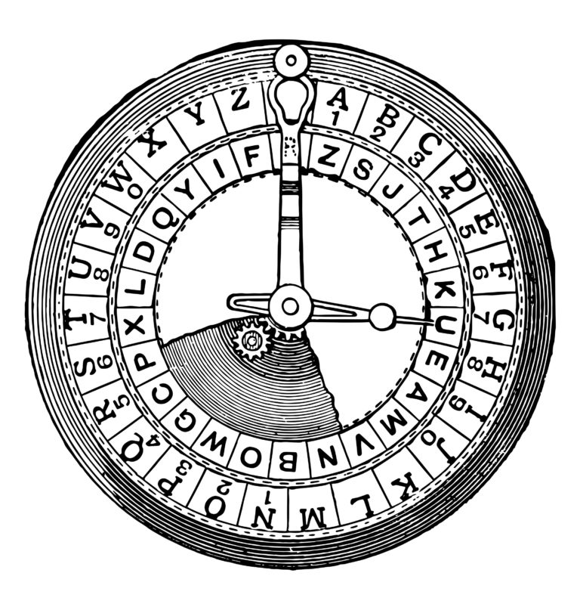

Objectives
Build a functional encryption and decryption tool that emphasizes clarity and simplicity.
01.
Enhance user interaction with a clean, intuitive interface.
02.
Implement a customizable "Condition Number" to allow variable encryption complexity.
03.
Use the project as an educational tool to understand encryption principles and algorithms.
04.

Slide 5
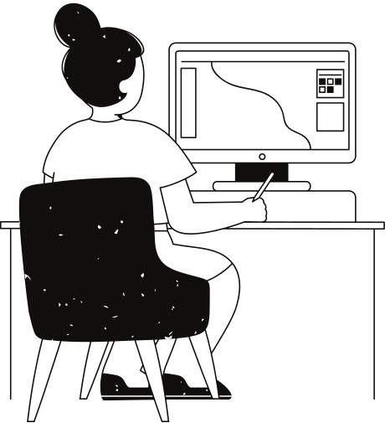
Benefits of the Project
Security: Protects sensitive information from unauthorized access.
Educational Value: Demonstrates key principles of encryption in a practical setting.
Customization: Adjustable "Condition Number" for varying encryption strength.
Ease of Use: Clear interface designed for all levels of technical expertise.
Scalability: Provides a foundation for incorporating advanced encryption techniques in the future.

Slide 6
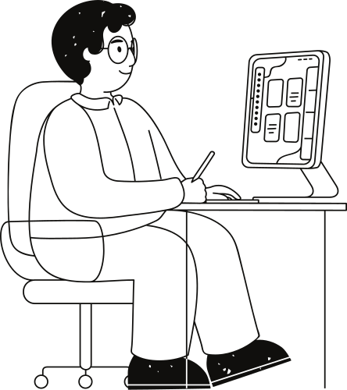

User Interface (UI)
Key Features:
Dropdown menu for selecting Encryption or Decryption.
Input box for user text and output box for processed text.
Buttons for increasing or decreasing the "Condition Number."
Modern design with responsive layouts and engaging color themes.
Technology Used:
HTML for structure
CSS for styling
JavaScript for functionality

Slide 7
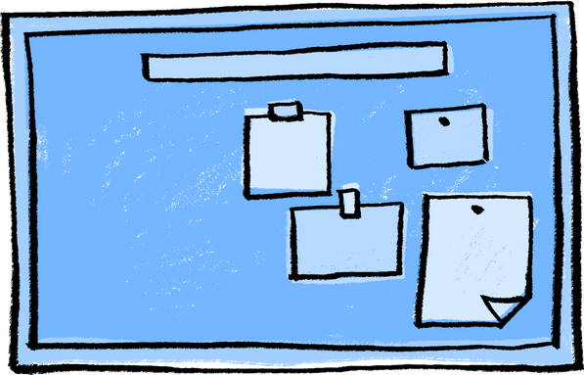
Hardware Specifications
01
02
03
Minimum Requirements:
Processor: Dual-core 2.0 GHz
Recommended Specifications:
Processor: Quad-core 2.5 GHz
Minimum Requirements:
RAM: 2 GB
Recommended Specifications:
RAM: 4 GB or higher
Minimum Requirements:
Browser: Modern browsers (Chrome, Firefox, or Edge)
Recommended Specifications:
Display: Full HD

Slide 8
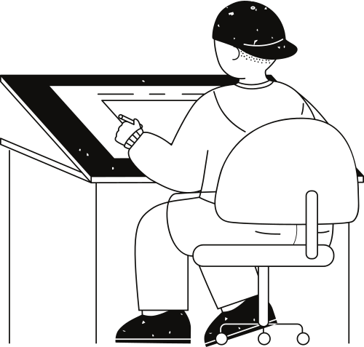






Project Demo
Exploring creativity

Slide 9


Conclusion
Summary:
This project simplifies encryption and decryption, combining historical methods with modern usability. It introduces algorithmic concepts and demonstrates their practical application.
Future Scope:
Extend support for file encryption/decryption.
Integrate advanced algorithms like AES and RSA.
Develop a mobile-friendly version for better accessibility.

Slide 10


Question & Answer!?

Slide 11

Thank you very much!

